Slide 1

Converting Casual Riders to Members
By: Nicolas Son

Slide 2

Table of Contents
Introduction
Problem
Analysis
Solutions
Conclusion

Slide 3

Introduction
Cyclistic is a bike-share program for mostly leisurely riders, while about 30% of riders use the bikes to commute to work daily. They also offer different modes of transportation, allowing even people with disabilities or riders who can’t use a two-wheeled bike a means of transit. They even offer different pricing plans, such as single-ride, full-day, and annual memberships.
Objective
Understand the differences between casual vs member riders
Identify key patterns
Propose a solution based on findings to convert from casual to member
Find out next steps after implementation

Slide 4
Problem
How do annual members and casual riders use Cyclistic bikes differently?
Why would casual riders buy Cyclistic annual memberships?
How can Cyclistic use digital media to influence casual riders to become members?

Slide 5
Analysis
Procedure | Description
Acquire the Data | Provided straight from Cyclistic, only Q1 2019 and Q1 2020 as 2 CSVs.
Clean the Data | Uploaded to posit.cloud, sync column names, reassigned data types (char to int), removed unnecessary columns, added dates, checked for invalid data.
Analysis | CSV to Tableau to explore relation between user types, day of week, average ride length, and total rides.
Statistical Significance?

Slide 6
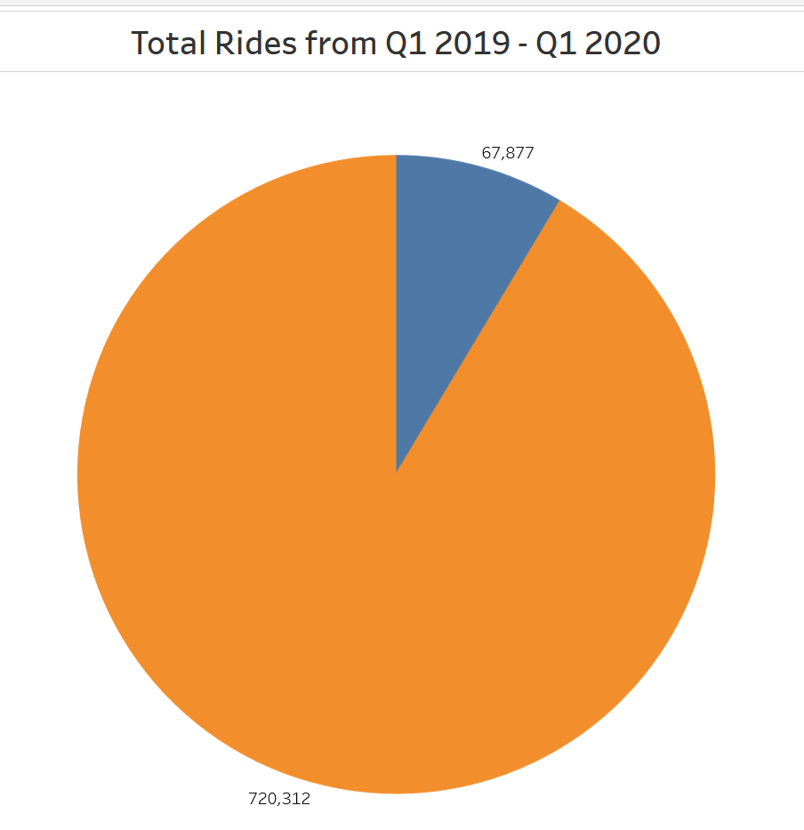
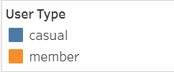

Slide 7
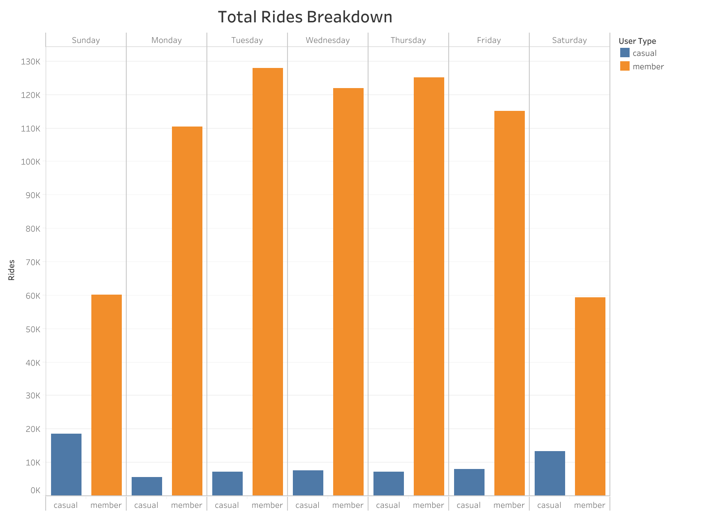

Slide 8
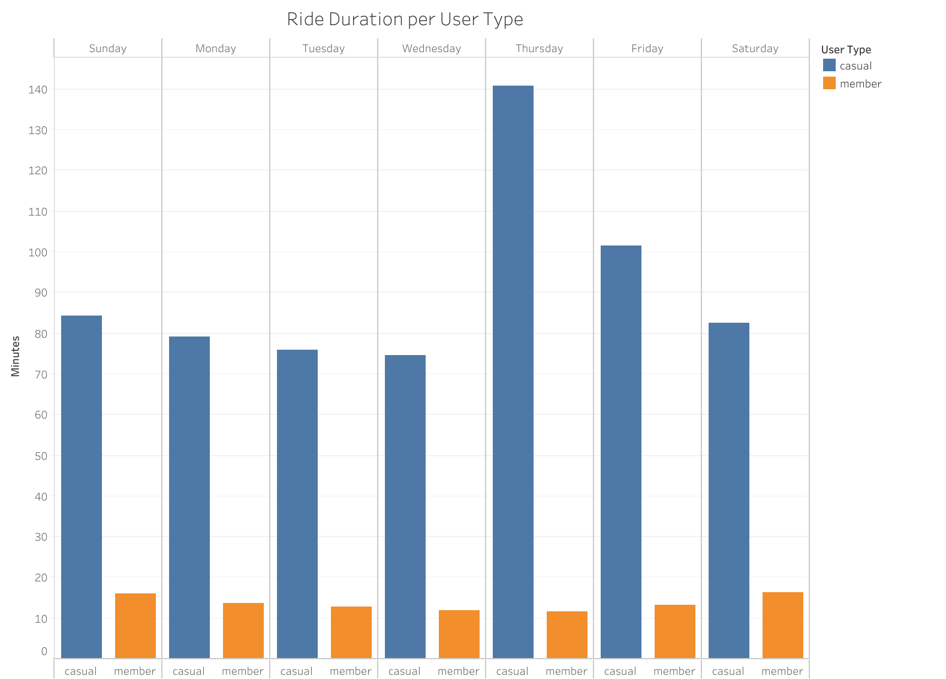

Slide 9
Key Points
Casual users only make up 8.9% of the userbase.
Casual users peak in ridership on weekends, vice versa for members.
Casual users ride for over 60 minutes on average any day of the week.

Slide 10
Solutions
Offer year-long members a discount for rides for at least over 30 minutes
Deals for riding a certain amount of times per week
Allow casual users a temporary member trial on the weekend
Create ads increasing awareness for this for casual members who have not yet tried membership.

Slide 11
Next Steps
Monitor how proposed solutions affect casual and member conversion
1
Identify most frequent timing to propose ads during an increase in ridership
2
Acquire more data to understand casual rider habits, such as why they ride for longer compared to members.
3

